Slide 1
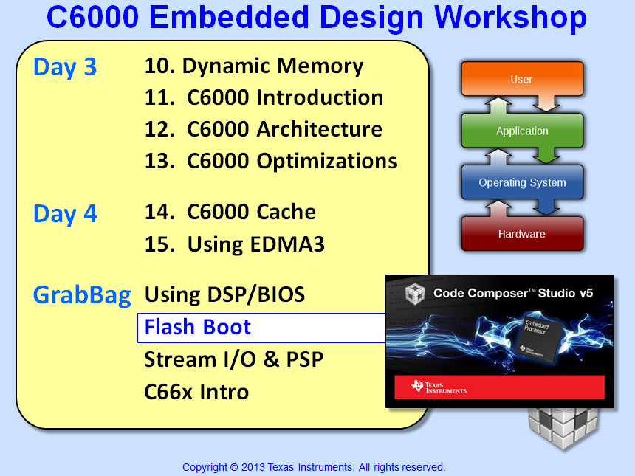

Slide 2
Objectives
Compare/contrast the startup events of CCS (GEL) vs. booting from flash
Describe how to use AISgen and SPI Flash Writer utilities to create and burn a flash boot image
Lab 16b – Convert the keystone lab to a bootable flash image, POR, run

Slide 3
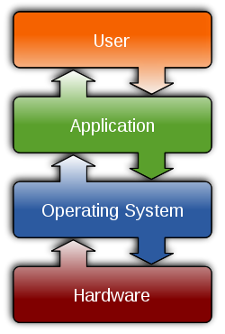

Outline
Boot Modes - Overview
System Startup
Initialization Files
Build Process
SPIWriter Utility
ARM + DSP Boot
Additional Info…
C6748 EVM Boot Modes
Lab 13b

Slide 4
‘C6748 Boot Modes - Overview
On RESET:
BOOT[x] pins are sampled
Corresponding boot routine is executed
ROM Code
0x11700000
BOOT Modes
BOOT[x]
NAND
NOR
HPI
I2C
SPI
UART
Boot Loader (ARM or DSP):
0
1
2
3
Runs out of L2 ROM
Copies FLASH → RAM
Execution begins at specified “entry point” (reset vector)
Questions
What else does the user need to configure? (GEL vs. Boot)
How is the “flash image” created? (AIS)
How is the EVM6748 Flash programmed? (SPIWriter)
Notes:
This was stolen from the IW6455 Workshop and then modified.
The key points are as follows:
Stand alone, the EVM will boot from FLASH if set up in the default configuration. The default program is a demo routine that just loops to itself.
When connected to CCS the emulator takes over control of the dsp
A GEL file executes whenever CCS connects to a target.
A “smart” loader in CCS knows how to take the sections from the .out file and place them at their correct locations in memory.
The default configuration (a combination of what happens at reset and what happens in the demo program) has L1s configured as cache and L2 configured as SRAM. Interrupts are off at this point.
During load of the .out file the program counter is initialized.
7) CCS then tells the DSP to run (when the run button is pressed)

Slide 5
Outline
Boot Modes - Overview
System Startup
Initialization Files
Build Process
SPIWriter Utility
ARM + DSP Boot
Additional Info…
C6748 EVM Boot Modes
Lab 13b

Slide 6
System Startup – CCS vs. Boot
Required Task CCS Boot
PLL Init GEL file AISgen.cfg
DDR Config GEL file AISgen.cfg
PINMUX GEL file AISgen.cfg
PSC GEL file AISgen.cfg
Load Program CCS loader ROM code
AIS – Application Image Script
When using CCS, the GEL file takes care of important setup FOR YOU
When using a boot loader, the user is responsible for writing code to accomplish the same tasks (e.g. AIS…)
Let's look a little closer at the details of GEL and AIS...
Notes:
This was stolen from the IW6455 Workshop and then modified.
The key points are as follows:
Stand alone, the EVM will boot from FLASH if set up in the default configuration. The default program is a demo routine that just loops to itself.
When connected to CCS the emulator takes over control of the dsp
A GEL file executes whenever CCS connects to a target.
A “smart” loader in CCS knows how to take the sections from the .out file and place them at their correct locations in memory.
The default configuration (a combination of what happens at reset and what happens in the demo program) has L1s configured as cache and L2 configured as SRAM. Interrupts are off at this point.
During load of the .out file the program counter is initialized.
7) CCS then tells the DSP to run (when the run button is pressed)

Slide 7
Outline
Boot Modes - Overview
System Startup
Initialization Files
Build Process
SPIWriter Utility
ARM + DSP Boot
Additional Info…
C6748 EVM Boot Modes
Lab 13b

Slide 8
CCS GEL File
The GEL script runs every time you connect to your target (C6748.gel).
This script sets up the target environment:
Mem Map
PSC
Core Freq
DDR
EMIF
PINMUX
PLL0
PLL1
Runs at “Connect To Target”
.GEL Snippets
OnTargetConnect( )
{
Clear_Memory_Map();
Setup_Memory_Map();
PSC_All_On_Experimenter();
Core_300MHz_mDDR_132MHz();
}
Setup_Memory_Map()
{
/* DSP */
GEL_MapAddStr( …); //DSP L2 ROM
GEL_MapAddStr( … ); //DSP l2 RAM
GEL_MapAddStr( … ); //DSP L1P RAM
Set_Core_300MHz();
Set_mDDR_132MHz();
Notes:
This is a fragment of the GEL file for the DM6437 EVM board.
GEL stands for General Extension Language. It is a C-like scripting language that allows automating steps in CCS.
In comments of the GEL statements we can see references to the cache, pin multiplexer, power domains, PLL, and external memory interface. All of these items are being configured behind the scenes when CCS connects to the target.
The embedded target will not have CCS available to handle initialization. Previously, with the old HEX6x conversion tool the user would have had to write additional source code to handle the initialization that was done by CCS. The new hexAIS conversion tool allows the use of something called an Application Image Script that we will see later. This script replaces the GEL file and is executed by the boot loader program that is in the ROM of the DSP.

Slide 9

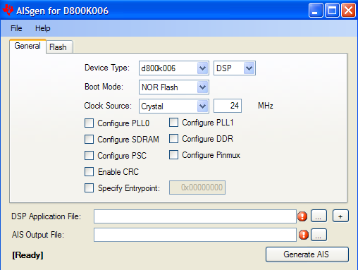
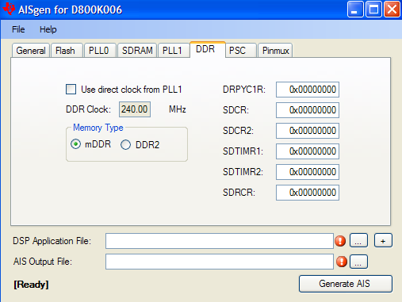
AISgen Conversion (.OUT → .BIN)
AISgen converts your .OUT file to a “flash”-able boot image (.bin)
Contains all of your app’s code/data sections
Can include user-defined code to set up environment:
Notes:
When hexAIS conversion runs it does two things. The first is that it does the same chore that was handled by the old HEX6x conversion tool. It takes a .out file and removes all the debug and line directives (all the DWARF code) and leaves only the executable code and data along with some section tag info (start address in rom, length, and load time location) so that the prom programmer knows where to put the bits into the FLASH chip and the boot loader knows where to put the sections when it reads the FLASH at start up.
The new thing is that an Application Image Script is also stored in the FLASH. This slide shows a portion of the script for the EVM. You will see initialization parameters for the PLL, DDR, and EMIF. Other things are set as well including power domains but you need to see the whole .ini file to see everything. This .ini file is stored in the FLASH along with everything else. It is read at startup by the boot loader routine in the ROM of the DSP and the boot loader uses this script info to initialize the registers of the DSP. The net result is faster initialization, no additional code required, and once you have a good script file the process is bullet proof.

Slide 10
Outline
Boot Modes - Overview
System Startup
Initialization Files
Build Process
SPIWriter Utility
ARM + DSP Boot
Additional Info…
C6748 EVM Boot Modes
Lab 13b

Slide 11
Build Steps : CCS/Debug vs FLASH
CCS
CCS: Project / Build
FLASH
CCS: Project / Build
file.out
file.out
C6748.gel
CCS: File / Ld Pgm
AISgen.cfg
AISgen
file.bin
SPIWriter.cmd
SPIWriter.OUT
Flash
SPI Flash
CCS forces
entry pt
to _c_int00
User specifies
Entry point
DDR2
DDR2
L1, L2, L3
L1, L2, L3
6748 EVM
6748 EVM

Slide 12
Outline
Boot Modes - Overview
System Startup
Initialization Files
Build Process
SPIWriter Utility
ARM + DSP Boot
Additional Info…
C6748 EVM Boot Modes
Lab 13b

Slide 13
SPIWriter Flash Utility - Procedure
SPIWriter is the “flash programming utility” that runs on the target and programs the flash with your .bin file
SIMPLE procedure:
Create your app.OUT file
Use AISgen to convert .OUT → .BIN using proper settings
Load/run SPIWriter_OMAP-L138.OUT file in CCS
Respond “no” to “UBL boot?”
Provide path to .BIN file (then flash erase/program occurs)
Terminate debug session, power-cycle, DONE.

Slide 14
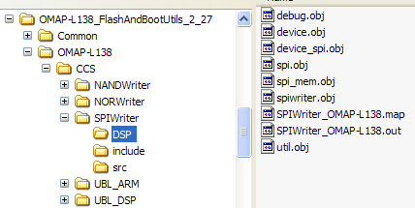
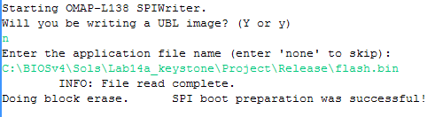
Using SPIWriter
SPIWriter is available for download at:
http://processors.wiki.ti.com/index.php/Serial_Boot_and_Flash_Loading_Utility_for_OMAP-L138
Part of a larger package of utils that includes writers for NAND, NOR, UBL_ARM, UBL_DSP

Slide 15
Outline
Boot Modes - Overview
System Startup
Initialization Files
Build Process
SPIWriter Utility
ARM + DSP Boot
Additional Info…
C6748 EVM Boot Modes
Lab 13b

Slide 16
ARM + DSP Boot (OMAP-L138)
ARM.out
.cfg
Unlock DSP
Set DSP reset vec
Wake DSP
DSP PC = reset vec
while(1)
PLL0
PLL1
SPI
DDR
PSC
flash.bin
ARM
AISgen
sect_1
sect_2
…
DSP.out
DSP
Audio Application
Link reset vector to specific addr (add reset vector to CFG)
sect_1
sect_2
…
ARM code programs DSP’s entry point to L2 addr
SYS/BIOS CFG file specifies exact entry point for boot
AISgen combines .out files into one bootable image

Slide 17
ARM + DSP Boot (OMAP-L138)
Host PC
Boot Pins
RESET
flash.bin
DSP+ARM
Image
ARM Bootloader
Copy ARM sections → L3
Copy DSP sections → L2
PC = ARM entry point
L2
ROM
C6748
“SPIWriter”
Flash
Programmer
ARM App
DSP App
Flash
Memory
EEPROM
Reset DSP
Audio
ARM Bootloader runs at reset, copies ARM/DSP sections to RAM
ARM App runs, wakes DSP, sets DSP PC = entry point, DSP runs
Both ARM and DSP programs are running simultaneously

Slide 18
Outline
Boot Modes - Overview
System Startup
Initialization Files
Build Process
SPIWriter Utility
ARM + DSP Boot
Additional Info…
C6748 EVM Boot Modes
Lab 13b

Slide 19
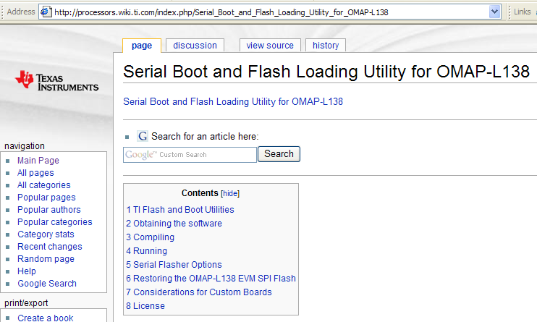
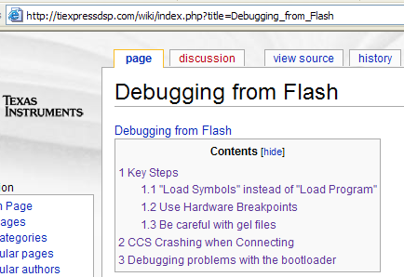

For Add’l Info…(Wiki & App Notes)
Notes:
FlashBurn will automatically connect to the target (indicated by the green checks on steps 1 and 2 above. The second step involves loading a FlashBurn Target Component file onto the target. This is the code that will run on the DSP to actually program the FLASH chip. The “free” version of FlashBurn has a FBTC file that is preconfigured just for the EVM’s memory map. If the customer has their own target system they will need the “full” version of FlashBurn in order to be able to configure the FBTC for their system’s memory map.
The next step is to point FlashBurn to the location of the hexAIS image file that we created in the previous conversion step. With that done all you need to do is erase the existing FLASH chip (with the provided button) and then burn the new image.
When this is done you can shut down CCS, power off the EVM, and disconnect the USB cable. Applying power to the board will cause a power on reset, the boot loader in the ROM onboard the DSP will begin to execute and it will pull in the hexAIS image from the FLASH, initialize the DSP, load the code and data into the correct runtime locations and then branch to _c_int00() to start the program. At this point the embedded system is up and running.

Slide 20
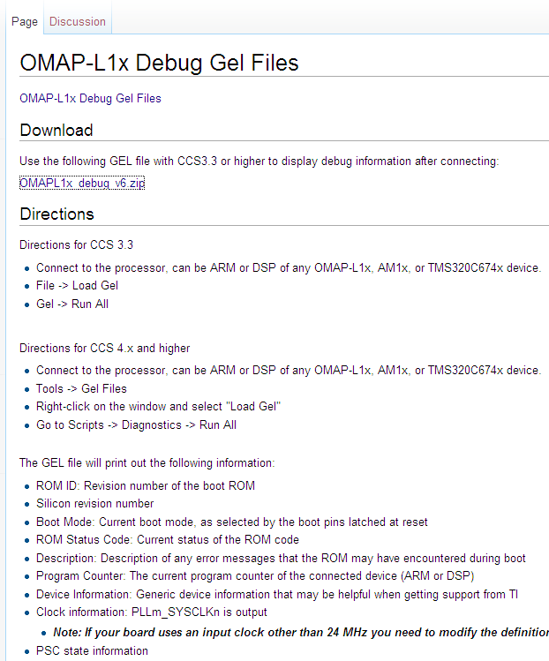
OMAP-L1x Debug GEL Files
Debug THIS !
ROM ID
Si Revision
Boot Mode
ROM Status Code
Boot ROM Errors
Current PC
Device Info
Clock Info
PSC States
Outputs results to the Console Window
Notes:
FlashBurn will automatically connect to the target (indicated by the green checks on steps 1 and 2 above. The second step involves loading a FlashBurn Target Component file onto the target. This is the code that will run on the DSP to actually program the FLASH chip. The “free” version of FlashBurn has a FBTC file that is preconfigured just for the EVM’s memory map. If the customer has their own target system they will need the “full” version of FlashBurn in order to be able to configure the FBTC for their system’s memory map.
The next step is to point FlashBurn to the location of the hexAIS image file that we created in the previous conversion step. With that done all you need to do is erase the existing FLASH chip (with the provided button) and then burn the new image.
When this is done you can shut down CCS, power off the EVM, and disconnect the USB cable. Applying power to the board will cause a power on reset, the boot loader in the ROM onboard the DSP will begin to execute and it will pull in the hexAIS image from the FLASH, initialize the DSP, load the code and data into the correct runtime locations and then branch to _c_int00() to start the program. At this point the embedded system is up and running.

Slide 21
Outline
Boot Modes - Overview
System Startup
Initialization Files
Build Process
SPIWriter Utility
ARM + DSP Boot
Additional Info…
C6748 EVM Boot Modes
Lab 13b

Slide 22
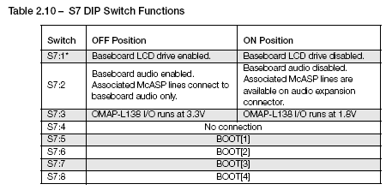
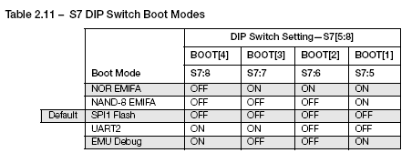
C6748 Boot Modes – S7 DIP_x
Notes:
FlashBurn will automatically connect to the target (indicated by the green checks on steps 1 and 2 above. The second step involves loading a FlashBurn Target Component file onto the target. This is the code that will run on the DSP to actually program the FLASH chip. The “free” version of FlashBurn has a FBTC file that is preconfigured just for the EVM’s memory map. If the customer has their own target system they will need the “full” version of FlashBurn in order to be able to configure the FBTC for their system’s memory map.
The next step is to point FlashBurn to the location of the hexAIS image file that we created in the previous conversion step. With that done all you need to do is erase the existing FLASH chip (with the provided button) and then burn the new image.
When this is done you can shut down CCS, power off the EVM, and disconnect the USB cable. Applying power to the board will cause a power on reset, the boot loader in the ROM onboard the DSP will begin to execute and it will pull in the hexAIS image from the FLASH, initialize the DSP, load the code and data into the correct runtime locations and then branch to _c_int00() to start the program. At this point the embedded system is up and running.

Slide 23
Flash Pin Settings – C6748 EVM
EMU MODE
SPI BOOT
8
ON
BOOT[4]
8
OFF
7
BOOT[3]
7
6
BOOT[2]
6
5
ON
BOOT[1]
5
4
NC
4
3
I/O (1.8/3.3)
3
2
Audio EN
2
1
LCD EN
1
SW7
SW7
Default = SPI BOOT

Slide 24
Outline
Boot Modes - Overview
System Startup
Initialization Files
Build Process
SPIWriter Utility
ARM + DSP Boot
Additional Info…
C6748 EVM Boot Modes
Lab 13b

Slide 25
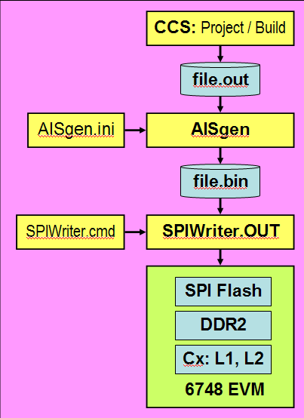
Lab 16b – ARM+DSP SPI FLASH Boot
Using AISgen & SPIWriter
Select “Keystone” Solution
Build “Release” config (.out)
Convert ARM and DSP .out files to .bin using AISgen
Run SPIWriter.OUT (burn flash)
Provide path to .bin
Success ?
Disconnect CCS
Power off/on – code runs
Time: 45 min
Workshop Students: Skip Lab Steps 1-6 (lab setup only)
Notes:
FlashBurn will automatically connect to the target (indicated by the green checks on steps 1 and 2 above. The second step involves loading a FlashBurn Target Component file onto the target. This is the code that will run on the DSP to actually program the FLASH chip. The “free” version of FlashBurn has a FBTC file that is preconfigured just for the EVM’s memory map. If the customer has their own target system they will need the “full” version of FlashBurn in order to be able to configure the FBTC for their system’s memory map.
The next step is to point FlashBurn to the location of the hexAIS image file that we created in the previous conversion step. With that done all you need to do is erase the existing FLASH chip (with the provided button) and then burn the new image.
When this is done you can shut down CCS, power off the EVM, and disconnect the USB cable. Applying power to the board will cause a power on reset, the boot loader in the ROM onboard the DSP will begin to execute and it will pull in the hexAIS image from the FLASH, initialize the DSP, load the code and data into the correct runtime locations and then branch to _c_int00() to start the program. At this point the embedded system is up and running.

Slide 26


Slide 27
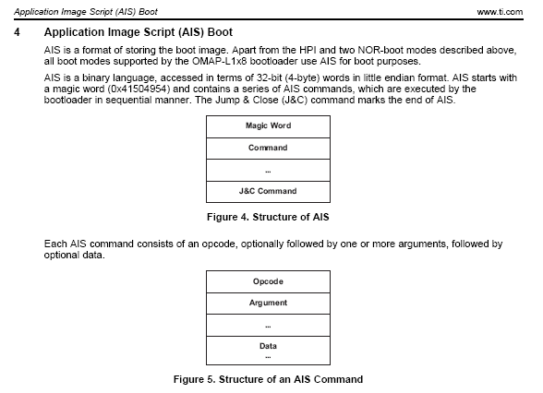
AIS – Boot Script
Notes:
FlashBurn will automatically connect to the target (indicated by the green checks on steps 1 and 2 above. The second step involves loading a FlashBurn Target Component file onto the target. This is the code that will run on the DSP to actually program the FLASH chip. The “free” version of FlashBurn has a FBTC file that is preconfigured just for the EVM’s memory map. If the customer has their own target system they will need the “full” version of FlashBurn in order to be able to configure the FBTC for their system’s memory map.
The next step is to point FlashBurn to the location of the hexAIS image file that we created in the previous conversion step. With that done all you need to do is erase the existing FLASH chip (with the provided button) and then burn the new image.
When this is done you can shut down CCS, power off the EVM, and disconnect the USB cable. Applying power to the board will cause a power on reset, the boot loader in the ROM onboard the DSP will begin to execute and it will pull in the hexAIS image from the FLASH, initialize the DSP, load the code and data into the correct runtime locations and then branch to _c_int00() to start the program. At this point the embedded system is up and running.

Slide 28
System Startup – CCS Load vs Flash Boot
RESET goes high
Sample boot pins
Peripheral, CPU registers reset
Load “app” from FLASH - IRAM / Cache setup
CCS halts CPU
Initialization GEL file sets up: - Interrupts - EMIF
CCS loads code & data to test
CCS releases target on ‘run’ cmd - Reset routine (_c_int00) - BIOS_init() - main() - init - BIOS_start() - BIOS scheduler begins
RESET goes high
Sample boot pins
Peripheral, CPU registers reset
AIS .BIN code sets up: - Interrupts - PLL - EMIF - DDR2
Load code from FLASH to RAM
Program begins from 0x 0000 0000 - Reset routine (_c_int00) - BIOS_init() - main() - init - IRAM/Cache setup - BIOS_start() - BIOS scheduler begins
Notes:
This was stolen from the IW6455 Workshop and then modified.
The key points are as follows:
Stand alone, the EVM will boot from FLASH if set up in the default configuration. The default program is a demo routine that just loops to itself.
When connected to CCS the emulator takes over control of the dsp
A GEL file executes whenever CCS connects to a target.
A “smart” loader in CCS knows how to take the sections from the .out file and place them at their correct locations in memory.
The default configuration (a combination of what happens at reset and what happens in the demo program) has L1s configured as cache and L2 configured as SRAM. Interrupts are off at this point.
During load of the .out file the program counter is initialized.
7) CCS then tells the DSP to run (when the run button is pressed)

Slide 29
User Code - Cache Setup via BCACHE API
#include <bcache.h> // headers for BIOS Cache functions
setCache() {
char * DDR2BASE = (char *) 0x80000000; // Pointer to DDR2 base addr struct int DDR2SZ = 0x07D00000; // size of DDR2 area on DM6437 EVM BCACHE_Size cachesize; // L1 and L2 cache size struct
BCACHE_setMode(BCACHE_L1D, BCACHE_NORMAL); // set L1D cache mode to normal BCACHE_setMode(BCACHE_L1P, BCACHE_NORMAL); // set L1P cache mode to normal BCACHE_setMode(BCACHE_L2, BCACHE_NORMAL); // set L2 cache mode to normal
cachesize.l1dsize = BCACHE_L1_32K; // L1D cache size 32k bytes cachesize.l1psize = BCACHE_L1_32K; // L1P cache size 32k bytes cachesize.l2size = BCACHE_L2_0K; // L2 cache size ZERO bytes BCACHE_setSize(&cachesize); // set the cache sizes
BCACHE_inv(DDR2BASE, DDR2SZ, TRUE); // invalidate DDR2 cache region BCACHE_setMar(DDR2BASE,DDR2SZ,BCACHE_MAR_ENABLE); // all DDR2 is now cacheable
}
Notes:
This was stolen from the IW6455 Workshop and then modified.
The key points are as follows:
Stand alone, the EVM will boot from FLASH if set up in the default configuration. The default program is a demo routine that just loops to itself.
When connected to CCS the emulator takes over control of the dsp
A GEL file executes whenever CCS connects to a target.
A “smart” loader in CCS knows how to take the sections from the .out file and place them at their correct locations in memory.
The default configuration (a combination of what happens at reset and what happens in the demo program) has L1s configured as cache and L2 configured as SRAM. Interrupts are off at this point.
During load of the .out file the program counter is initialized.
7) CCS then tells the DSP to run (when the run button is pressed)

Slide 30
Outline
MainHighlight
MainNormal
SubHighlight
SubNormal

